Slide 1


SIM Annual Meeting: Behavioral Health
Quality Improvement Study
Shaun T. Alfreds, Chief Operating Officer
Katie Sendze, Director, Client Services
December 6, 2016

Slide 2

HIN SIM Behavioral Health (BH)
Project Goals
Implement connections between 20 BH organizations and the Health Information Exchange
  Train BH staff to leverage EHR and HIE services
  Document and share “Data Informed” workflows for patient care improvement
  Build data interfaces and go live with initial data available from each BH organization
Support quality improvement aimed at reducing ED Utilization and measure impact (“Observational Analysis”)

Slide 3
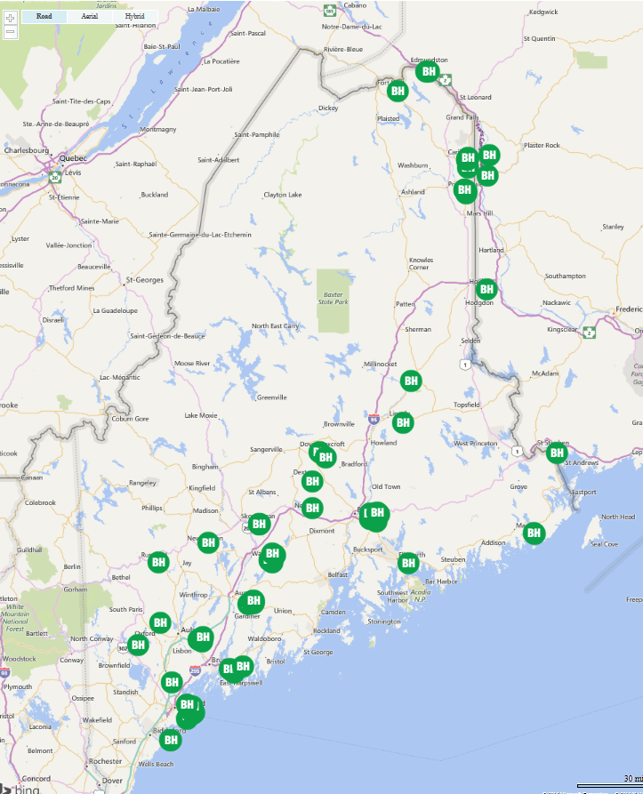
BH Connections as of October 2016
88 Site Locations Connected
Live with Data Sharing
Aroostook Mental Health Center
Assistance Plus
Charlotte White Center
Cornerstone Behavioral Healthcare
Crisis & Counseling Centers
Julie Racine, NP
Maine Behavioral Health Organization
Northeast Occupational Exchange
OHI
Pathways (Providence)
Restorative Health
Sweetser
United Cerebral Palsy

Slide 4
BH Staff Active HIE Access
May 2015 - October 2016

Slide 5
Population Impact
May 2015- October 2016

Slide 6
“Data Informed” Workflows Documented
Targeted Care Management Services
Hospital Discharge Planning
Comprehensive Transitional Care; Post ED and Hospital Follow up
Identification and Coordination with Client’s Care Team
Medication Reconciliation
Client Engagement and Education; Using the Client’s HIE record
Intervention with Client Following a Medical Event while Waiting for Reports from Medical Providers
Assessment of Accuracy of SMI Diagnosis vs. Medical Diagnosis with Medical Provider
Identification of Gaps / Overuse of Medical Care
Location of Missing Clients

Slide 7
Value of HIE in Managing Mental Illness and Chronic Disease
Reduce fragmentation with medical community
Mitigate medical issues that contribute to Mental Illness
Identify prescriptions, both unknown and duplicated
Provide a safety-net, locate clients and intervene
Provide integrated BH intervention to address medical issues and reduce unnecessary ED visitsedical care

Slide 8
BH Quality Project Goals
January-July 2016
Implement real-time notifications for ED/hospital admissions to intervene with clients with a history of 2 or more ED visits within a 6 month period
Access the HIN Portal to coordinate care with both the client & medical community
Leverage “Data Informed” workflows with all organizations and convene monthly “learning community” to share lessons learned
Measure change in ED utilization at the end of 6 month period (“Observational Analysis”)

Slide 9
MaineCare BH Quality Project;
Observational Analysis Overview
Hypothesis – Integrated care interventions that include medical record data and real-time notifications will reduce ED utilization for patients
Patients chosen for inclusion based on 2-or more ED visits in the 6-month “pre intervention” period
A list of 800+ patients was provided to the 18 BH organizations to determine appropriateness for intervention
A observation panel of 443 patients were selected by the 18 BH organizations participating

Slide 10
Analysis Results
(Preliminary)

Slide 11
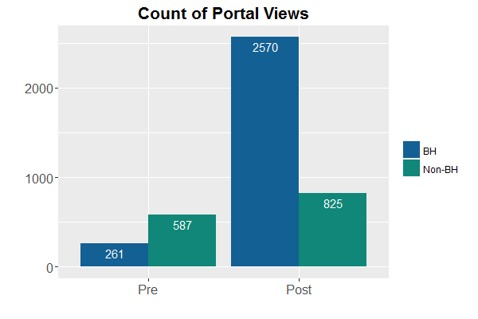
HIE Portal Views of Cohort Patients
Portal views increased in the post-intervention period, mostly by users from behavioral health facilities

Slide 12
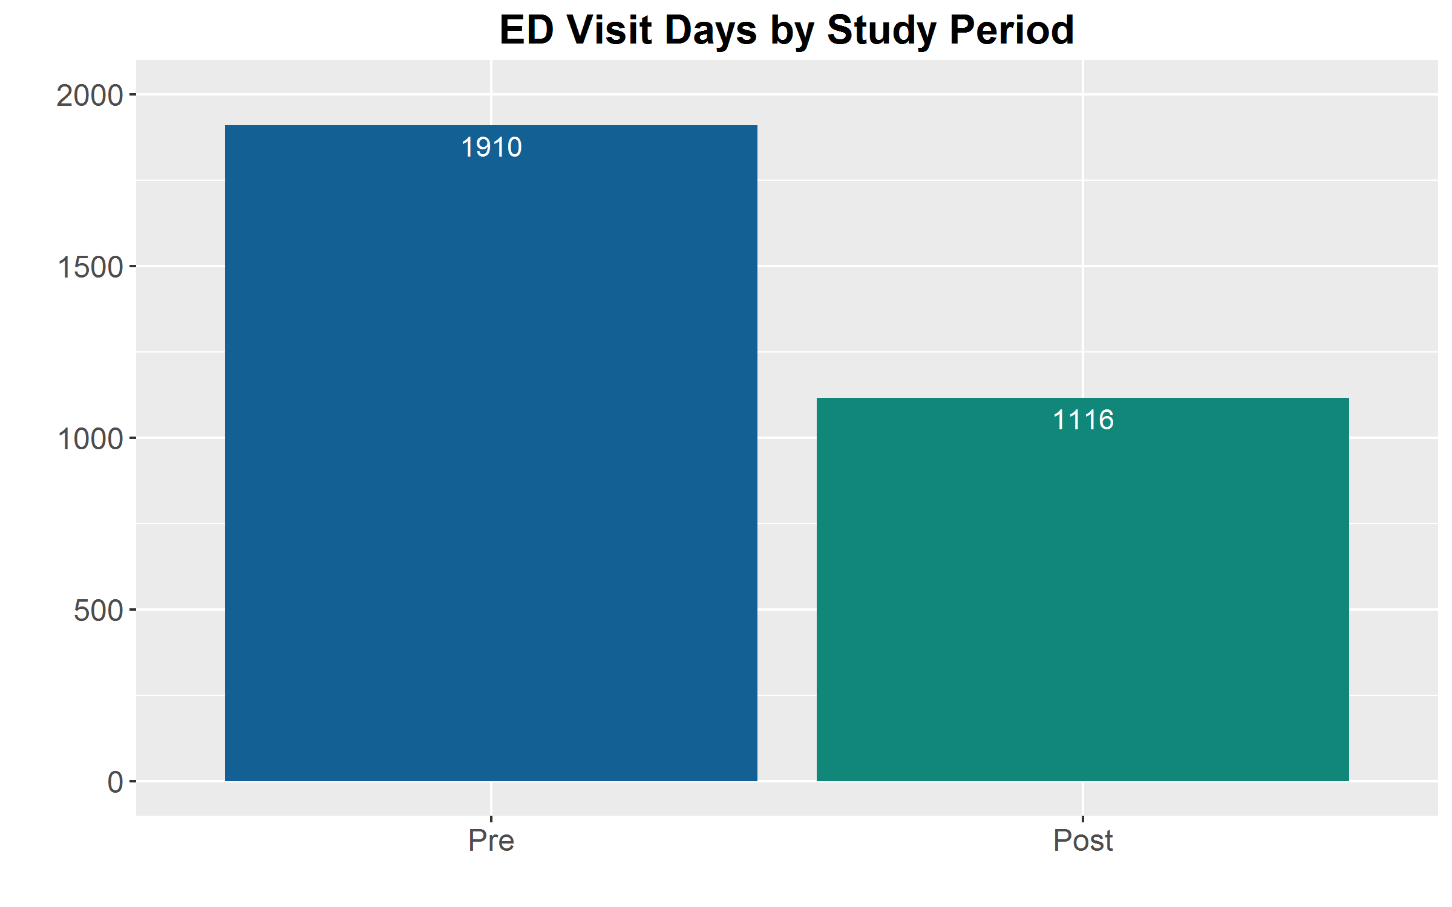
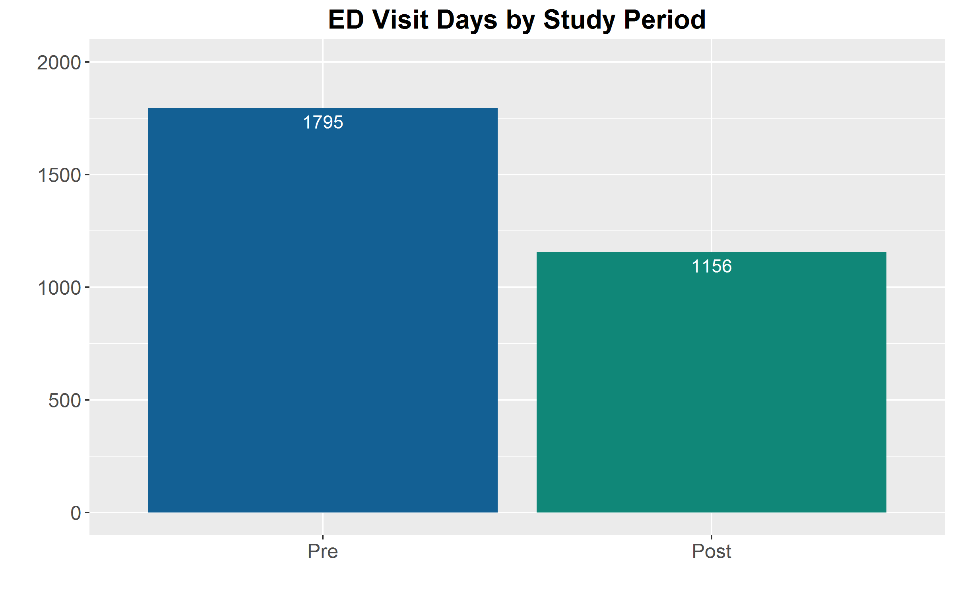
ED Visit Days
Claims Data
CDR Data
There was a 35%+ reduction in ED Visit Days for the cohort population in the post intervention period

Slide 13
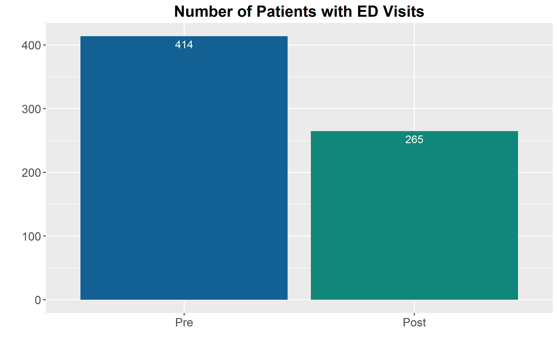
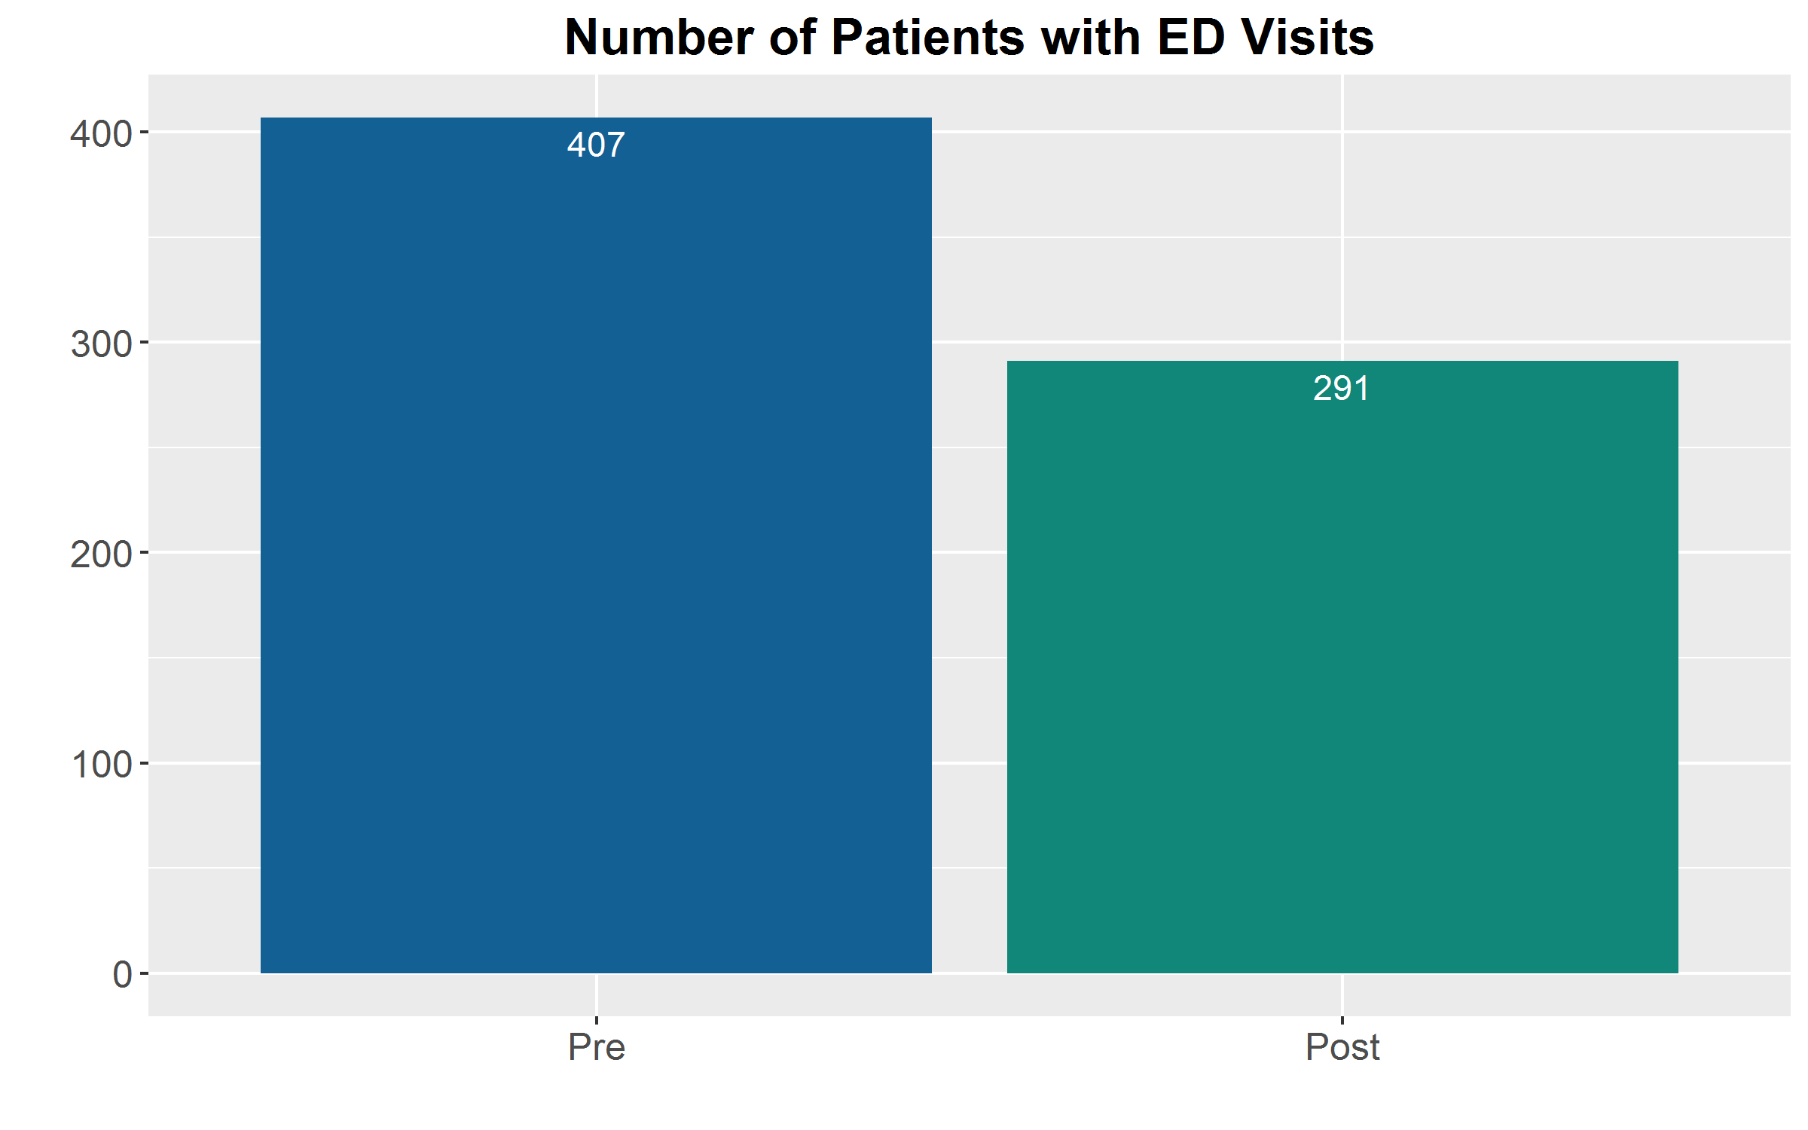
Patients with ED Visit Days
Claims Data
CDR Data
There was a 30%+ reduction in patients having ED visits in the post intervention period

Slide 14
Total ED Visit Rates
Mean ED Visit Rate for All patients (HIE Data) - Pre Intervention: 4.4 visits / 6 month period - Post Intervention: 2.7 visits / 6 month period
Mean ED Visit Rate for Patients with ED visits (HIE Data) - Pre Intervention: 5.1 visits / 6 month period - Post Intervention: 4.1 visits / 6 month period

Slide 15
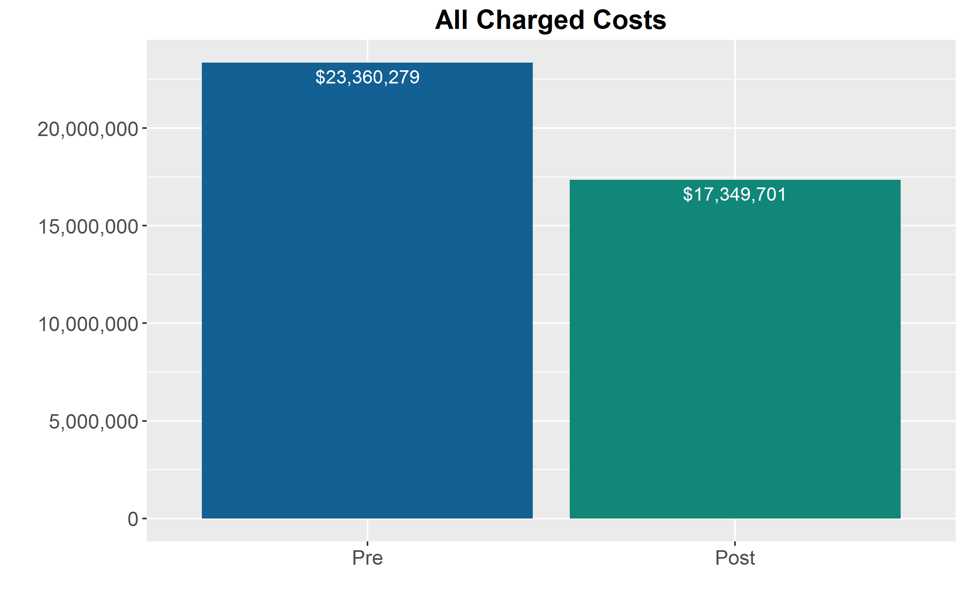
All Medical Charges
Total medical charges were $6,010,578 (34%) less in the post-intervention period
  Does not include pharmacy claims
  See analysis caveats and limitations slide for discussion
Claims Charge Data

Slide 16
Caveats and Analysis Limitations For Initial Observations
Sample bias: Patients were chosen by BHOs based on a comprehensive list
  Comment: While considered a bias in sampling, this may represent a policy means to engage health care organizations around a goal of health improvement
Observational vs Controlled: There was no control group for this analysis.
  Conclusions are observational in nature
  Results may be attributed to intervention and/or other uncontrolled for factors
Claims and Clinical Data Limitations: There is a big difference in data sets
  Clinical data – clear date and time but missing “high risk” data/encounters (MH/HIV)
  Claims – time is not included: must go through a manual process to create claims “encounters”
  Claims Lag – data is 60-90 days old before it is complete and adjudicated
Costs are difficult to aggregate for ED based on Claims
Did not look at ”appropriate” vs “inappropriate” use of the ED (focus for Year 4)
Data was not age or severity risk adjusted

Slide 17
Study Continuation
Analysis will be continued in SIM Grant Year 4
Address claims lag
Analyze paid data vs charge data
Increase timeframe (look-back period and intervention period (12 month))
Addition of control group/population
Addition of pharmacy claims
  Review polypharmacy impact
  Review $ impact
Analyze “appropriate” vs “inappropriate” ED utilization

Slide 18
Conclusions and Discussion
Data integration into workflow is resource intense for BHOs
  But when coordinated and “data informed” the impact can be significant - improving patient experience, improving appropriate utilization, and reducing cost
Few BHOs have dedicated staff to care management and workflow optimization
DHHS is supporting continuation of this work – through SIM Year 4
DHHS is investing in connecting BH Prior Authorization vendor to HIE to assist in getting BH data to HIE

